Slide 1
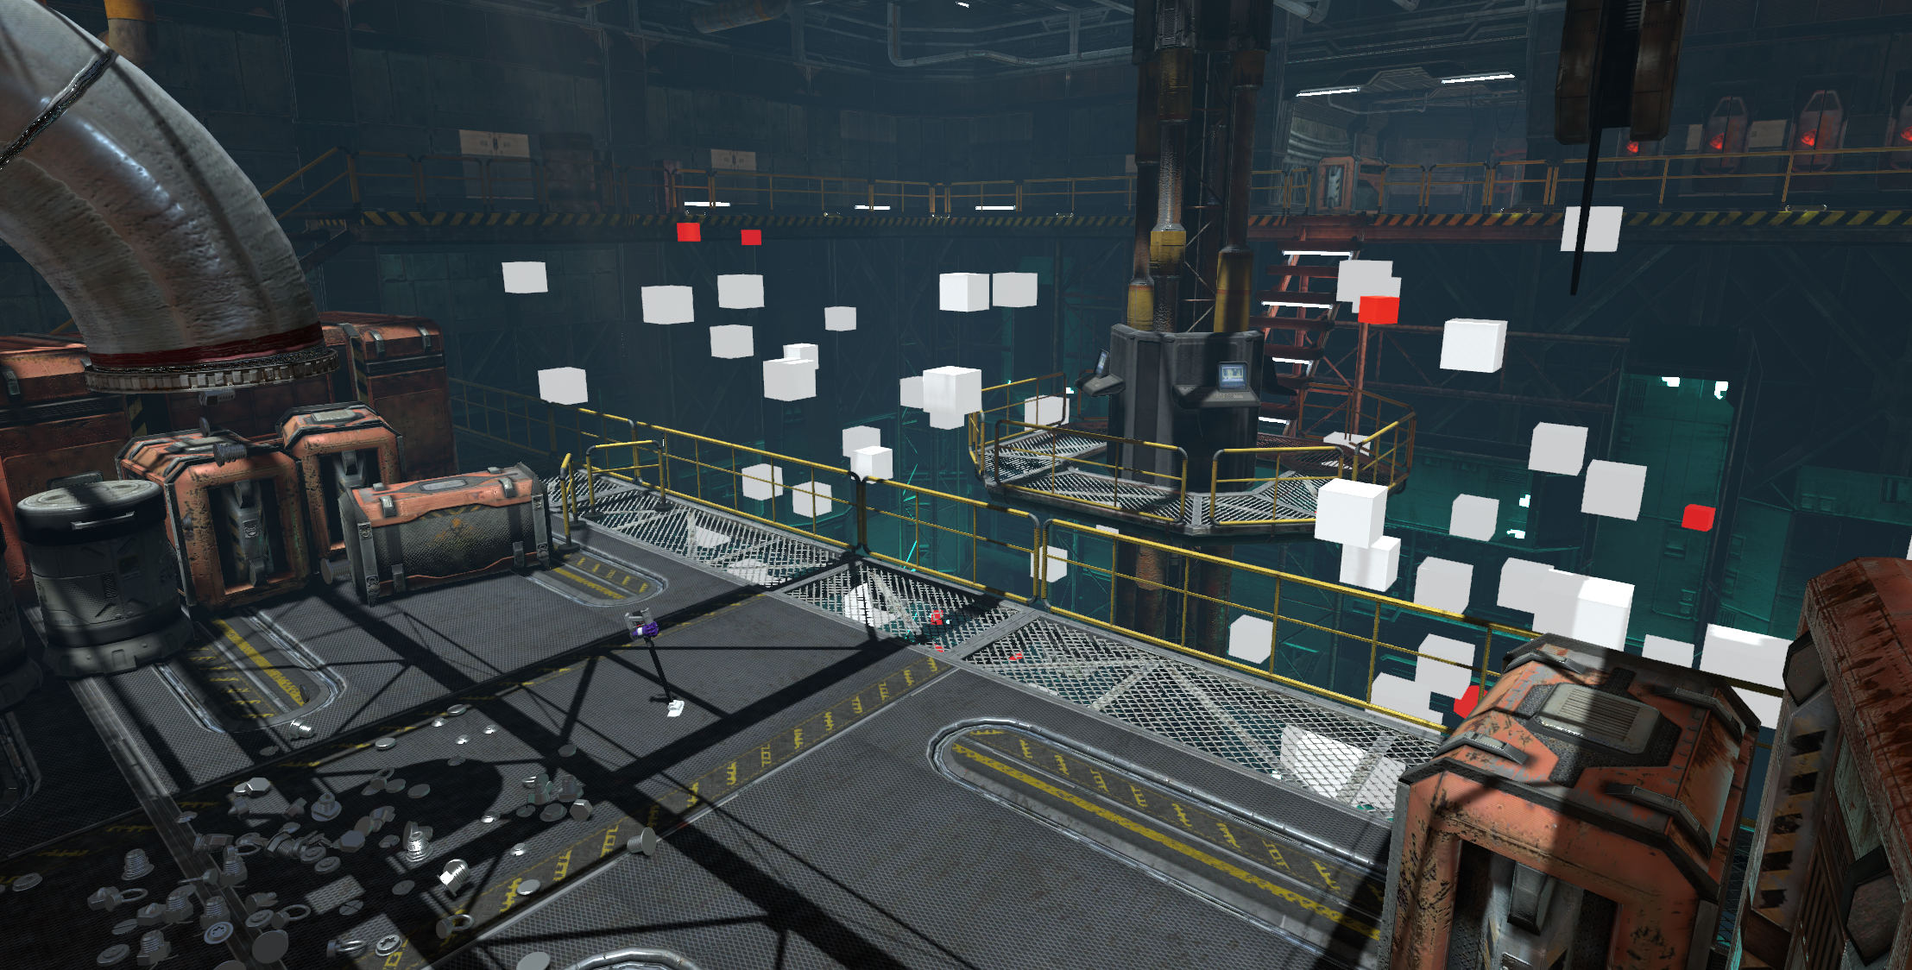
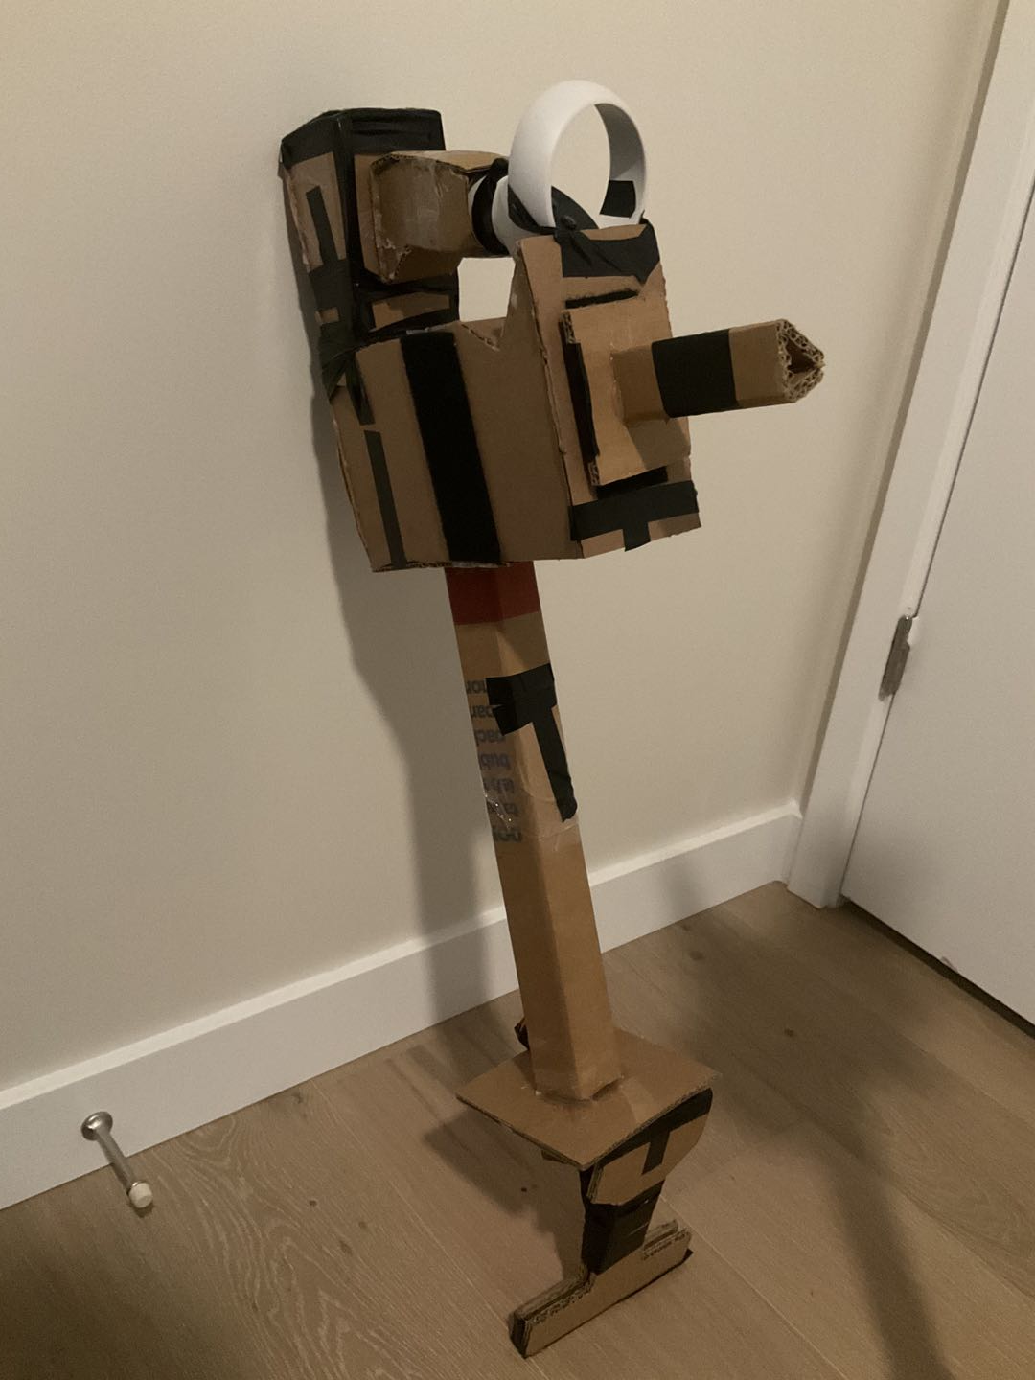
VACUUM WAR

Slide 2
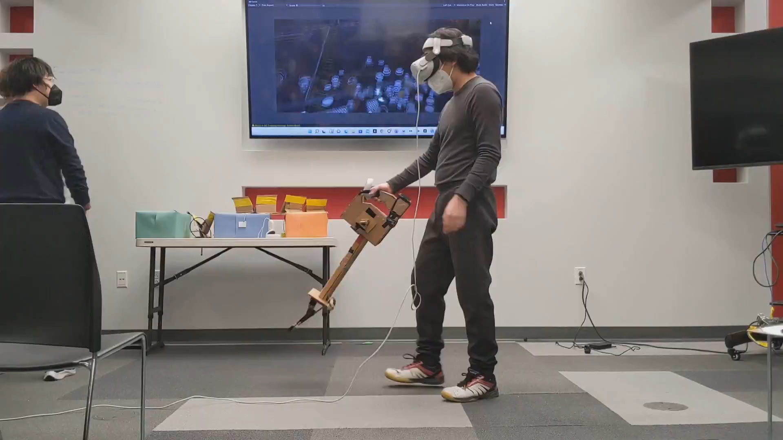
Demonstration: Dev Talk

Slide 3
Credits
Junce Wang
PRODUCER, DESIGNER, TECH ARTIST & ENGINEER
Tejas Ved
PROGRAMMING
Yiyu Wang
CONCEPT ART
Ben Crosby
AUDIO DESIGNER & CO-PRODUCER
Lei Zhao
HARDWARE ENGINEER
Chandler Jeffcoat
ANIMATION
Jonathan Conger
DESIGN
Tejas Kawalkar
PROGRAMMING
Kaisen Xue
ARTIST
Zeshi Chen
HARDWARE DESIGNER & TECH ARTIST
Faraz Ghorbanpour
HARDWARE ENGINEER
Xuan Zheng
GAME ART

Slide 4
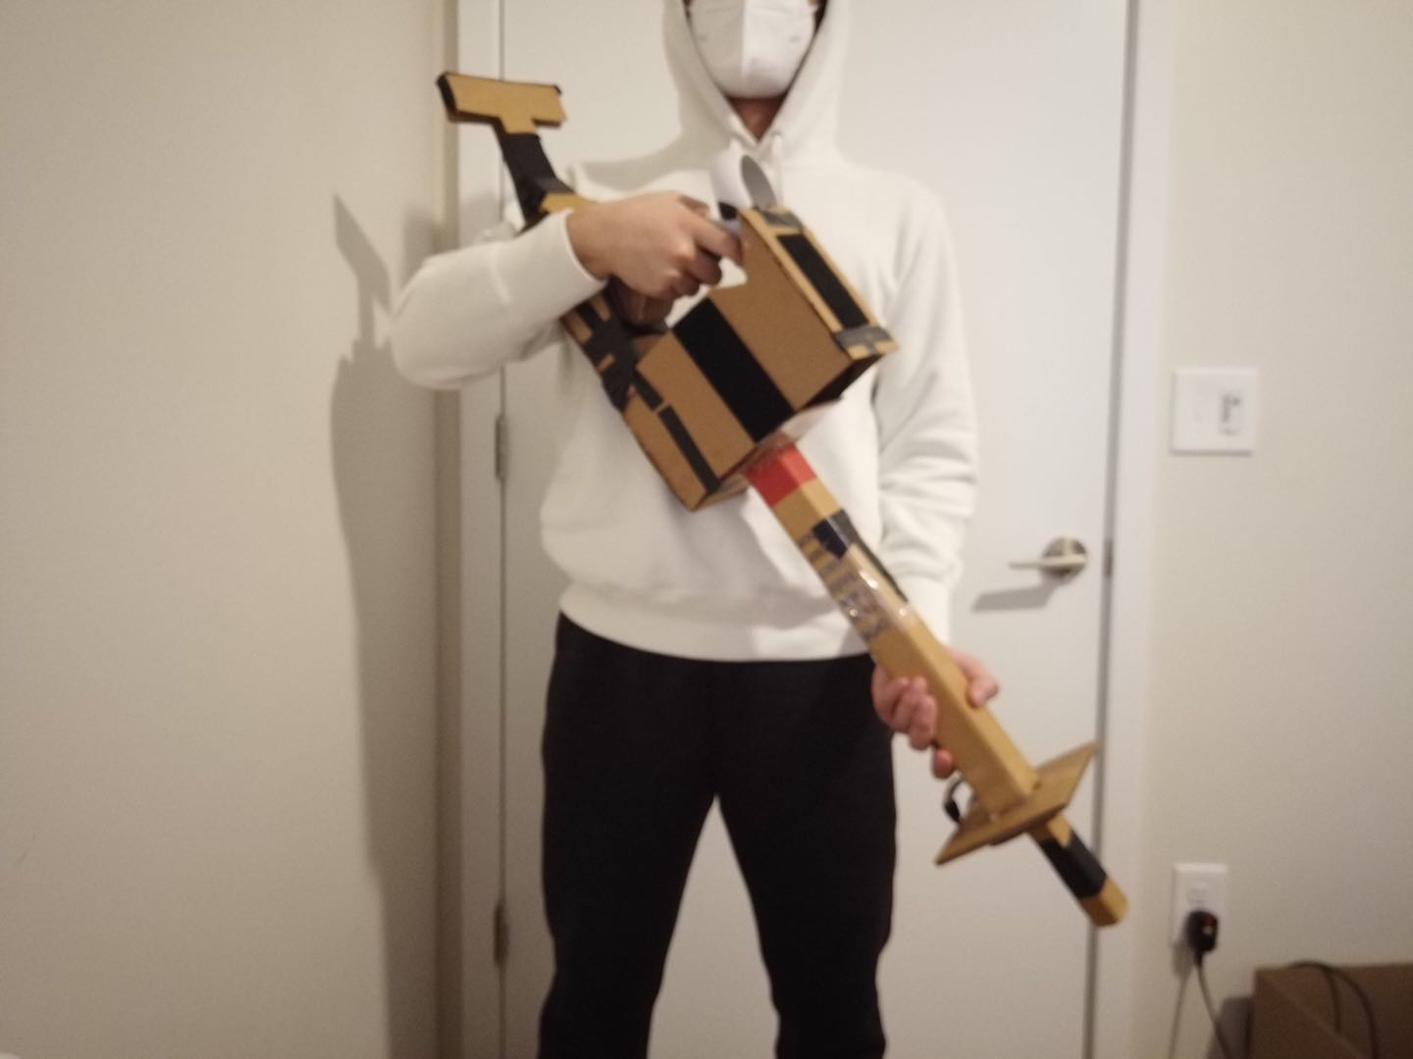
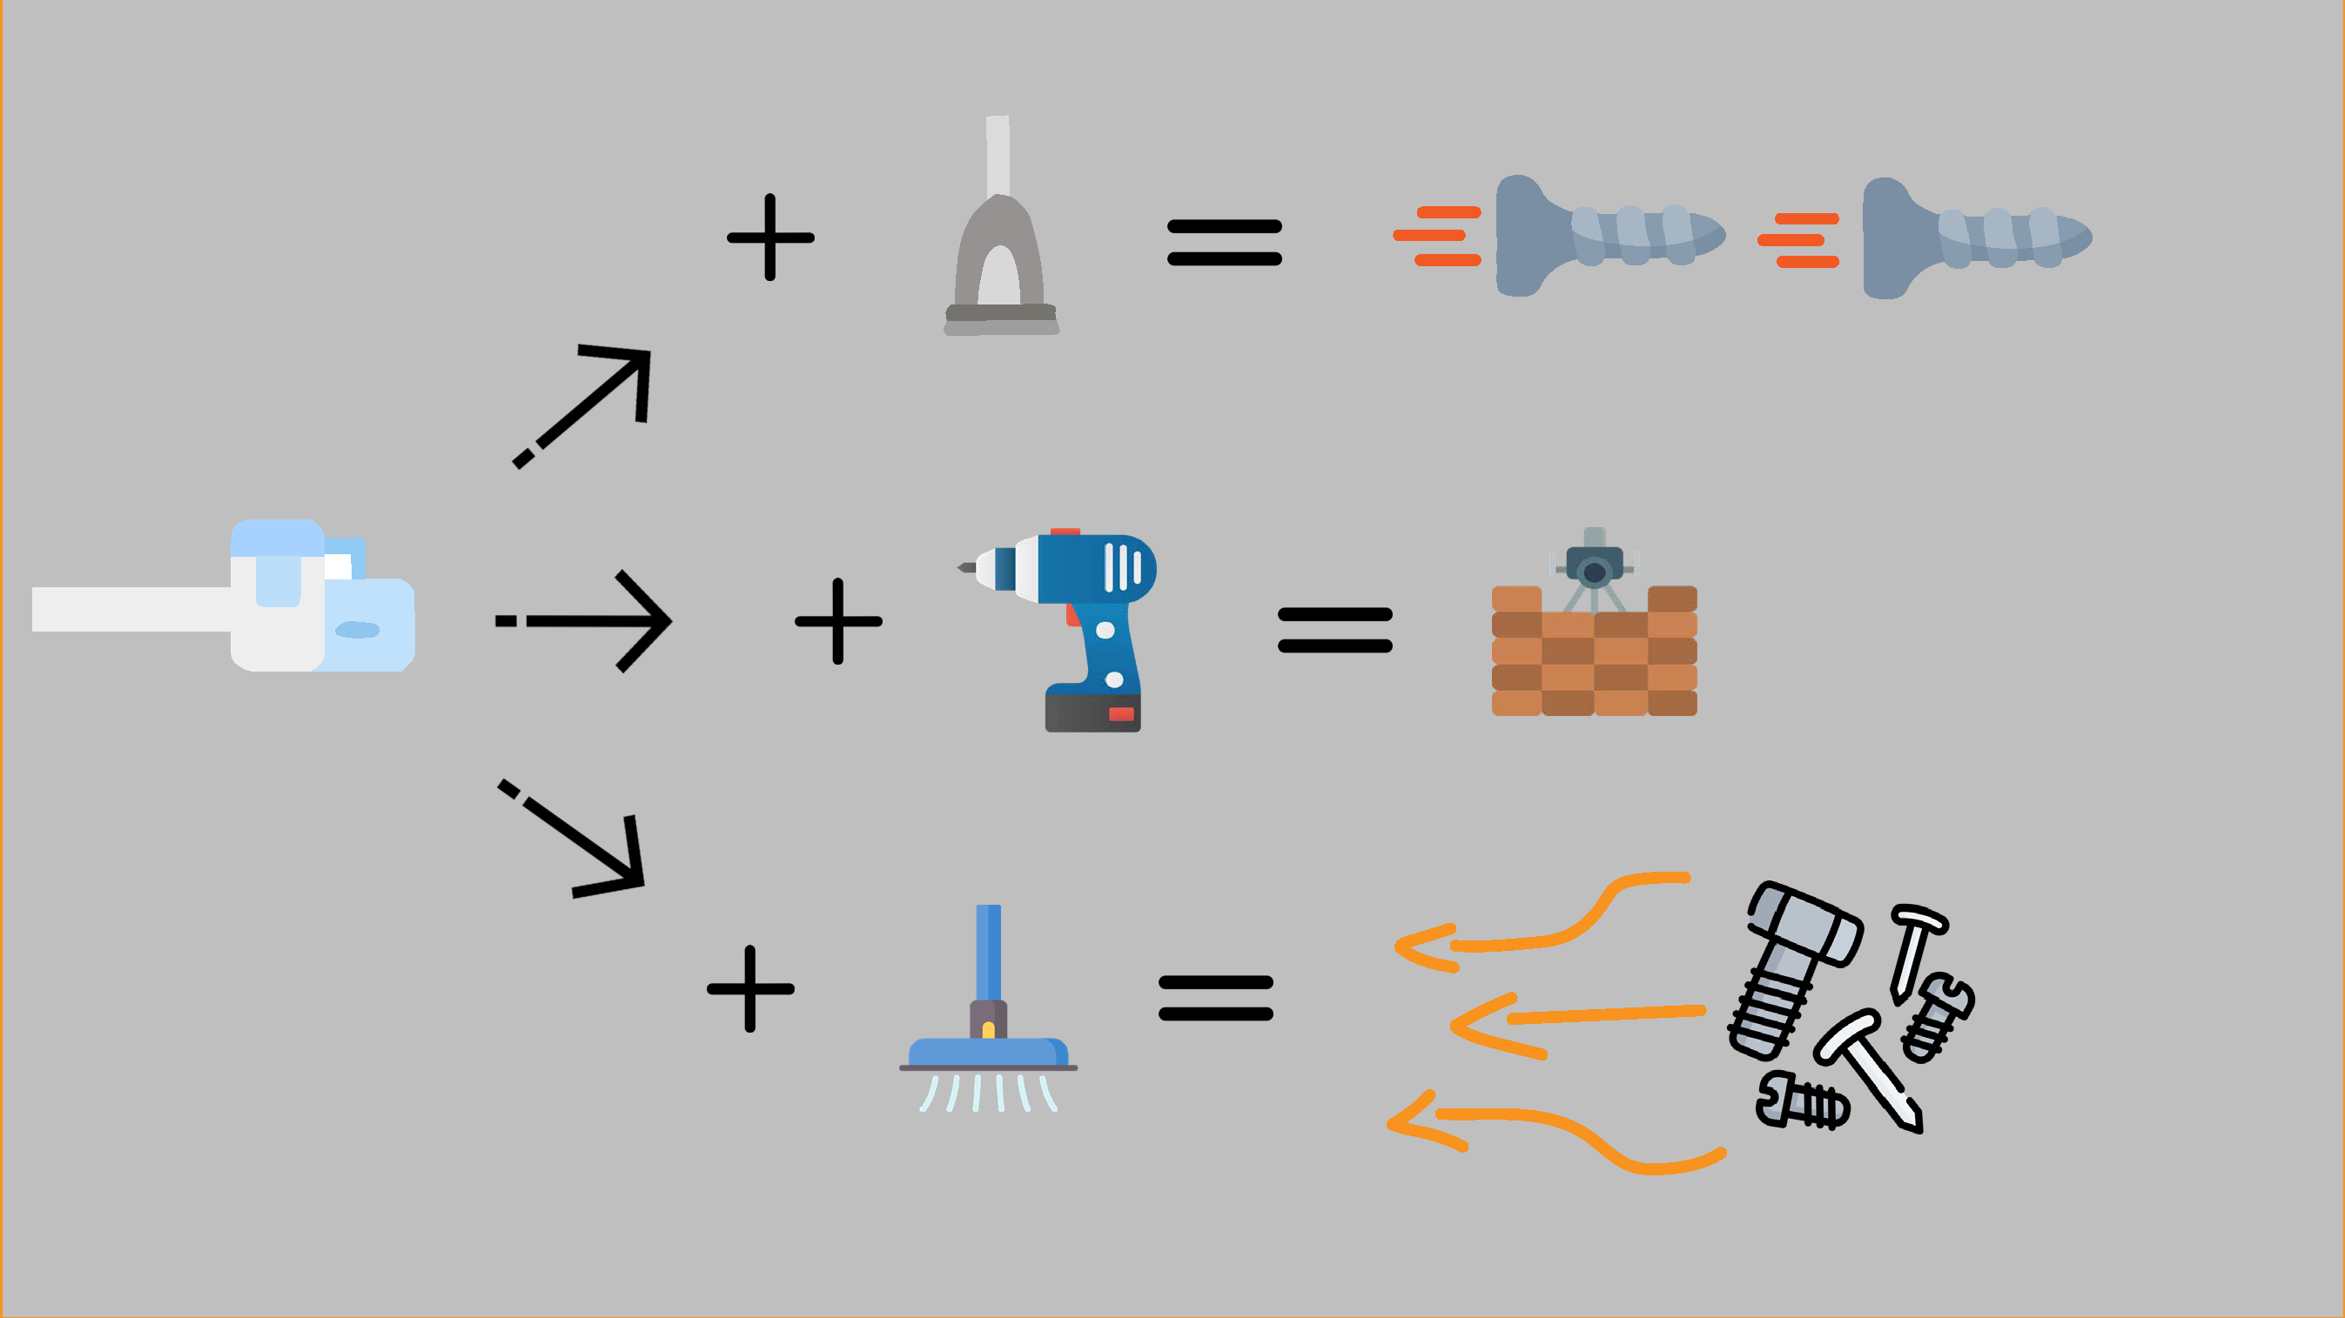
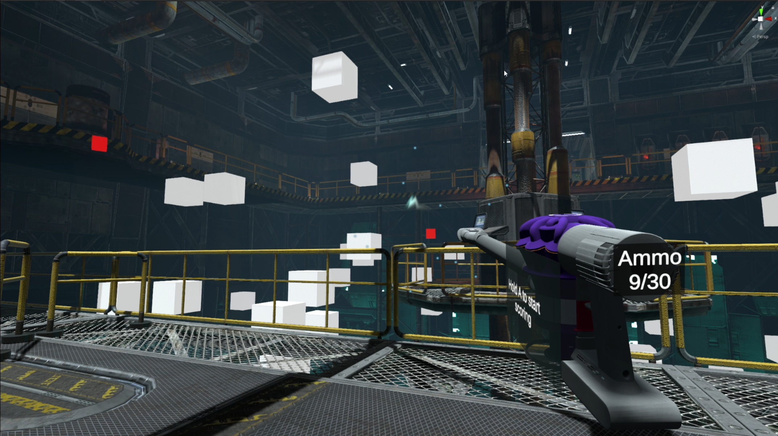
DESIGN PILLARS
Make-believe
Multifunctional Tool based on C12 games
*Avoid teleporting/moving or turning with joystick to preserve immersion.
Notes:
Make-believe: Fill the gap between imagination and reality. With a sweep you can image you’re fly. With a clog you can image that’s your sword. VR.
Multifunctional tool: Playability as a controller. RFID.

Slide 5
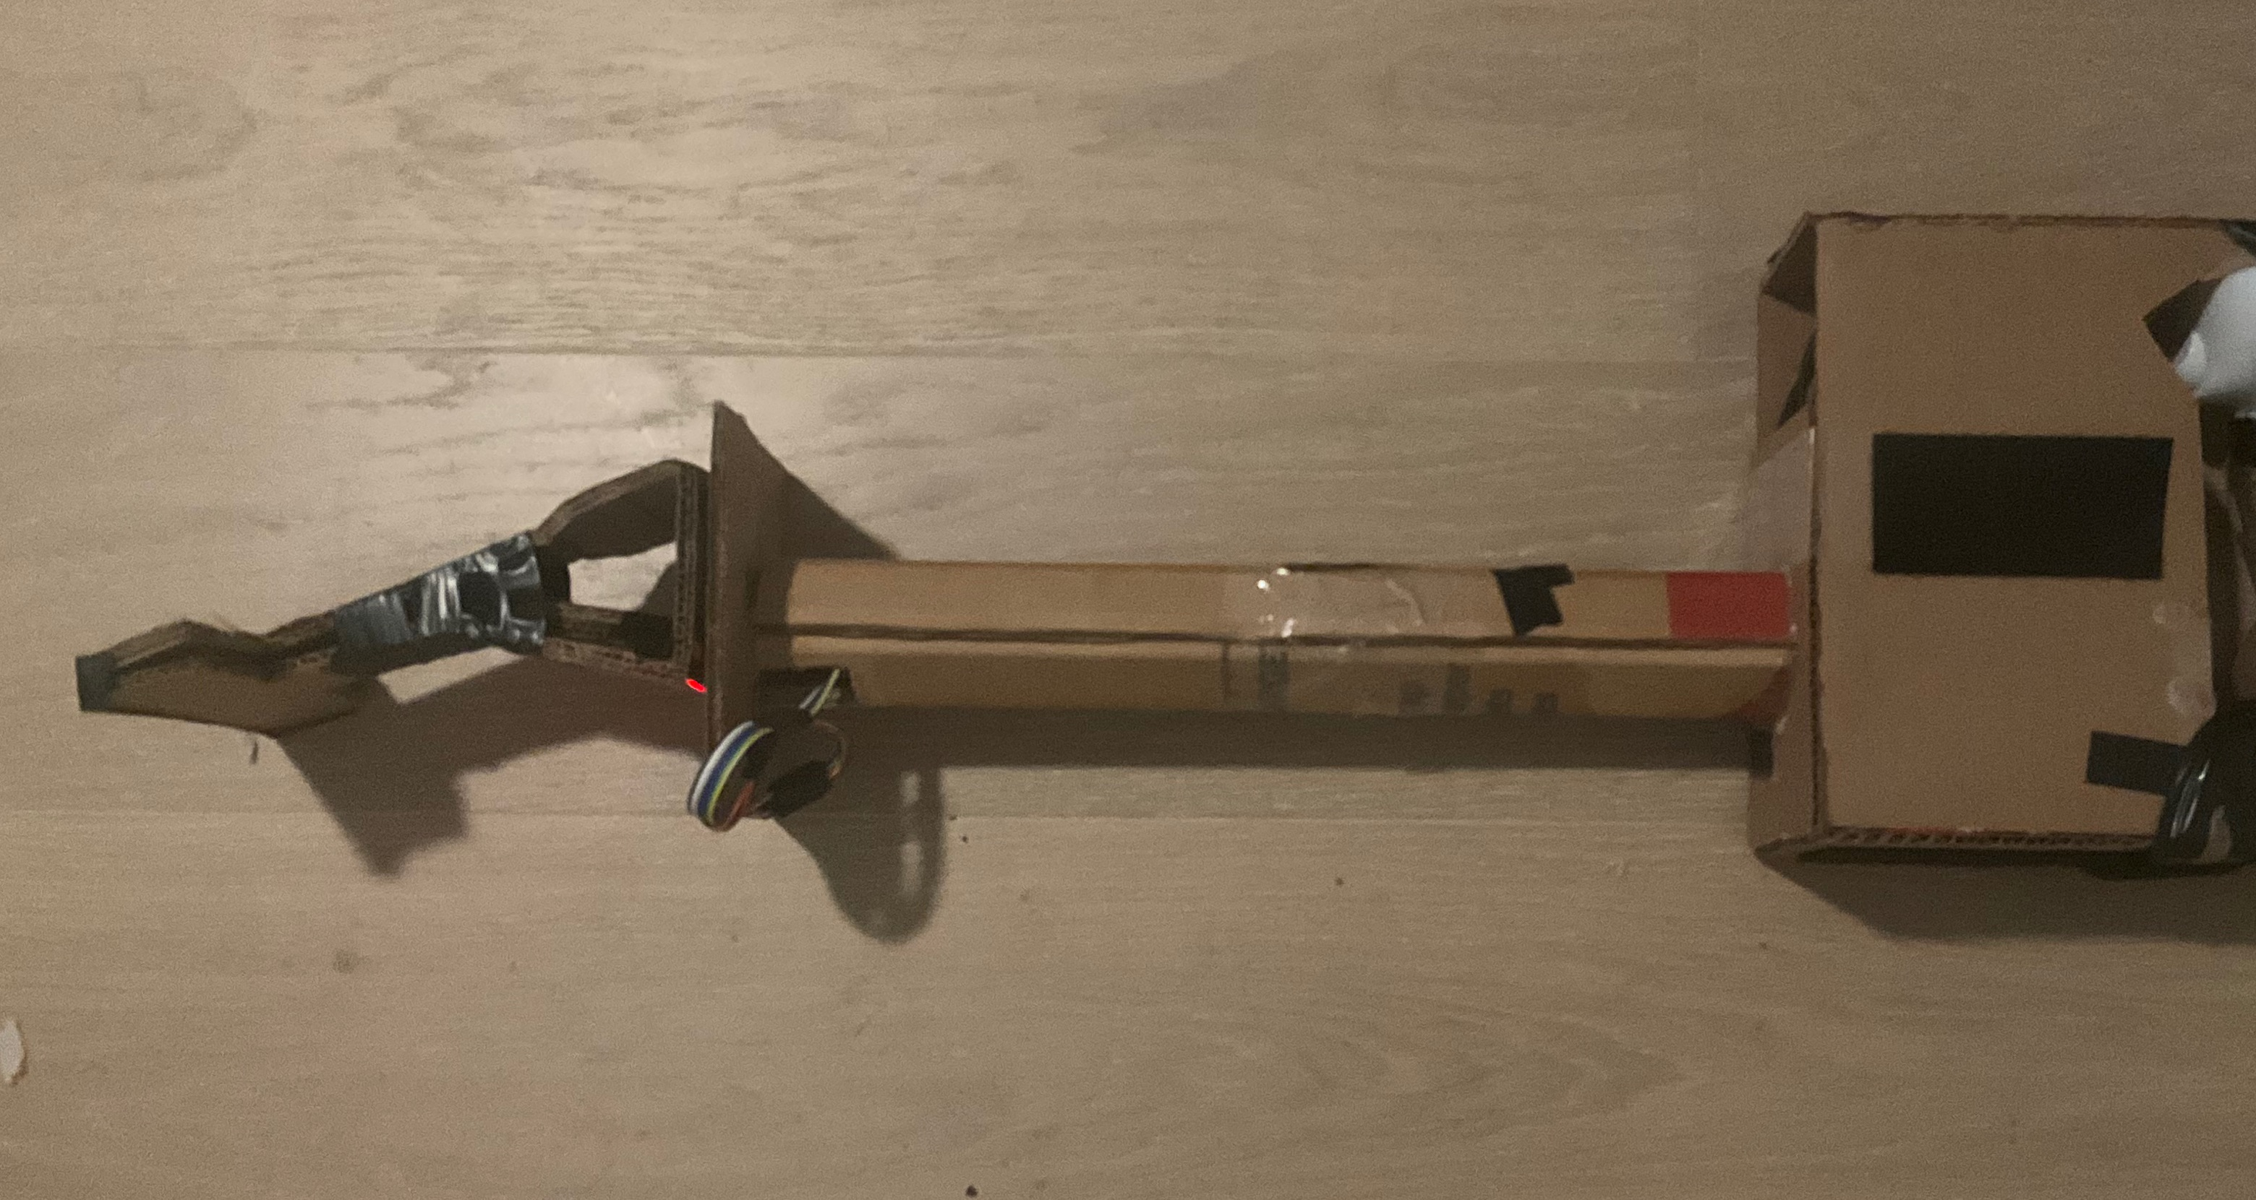
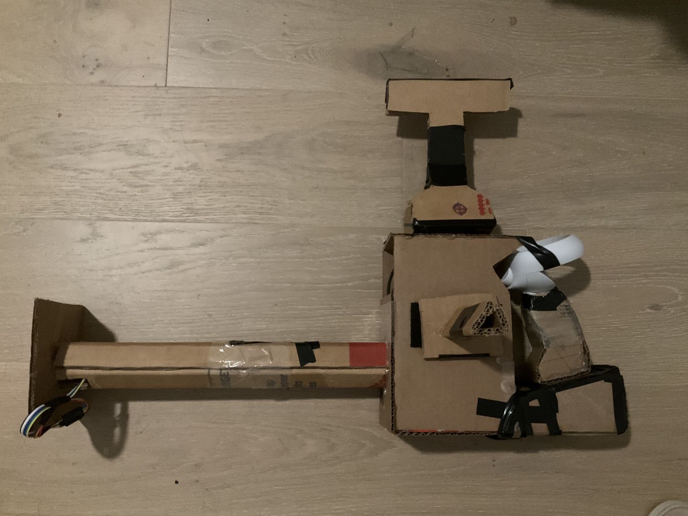
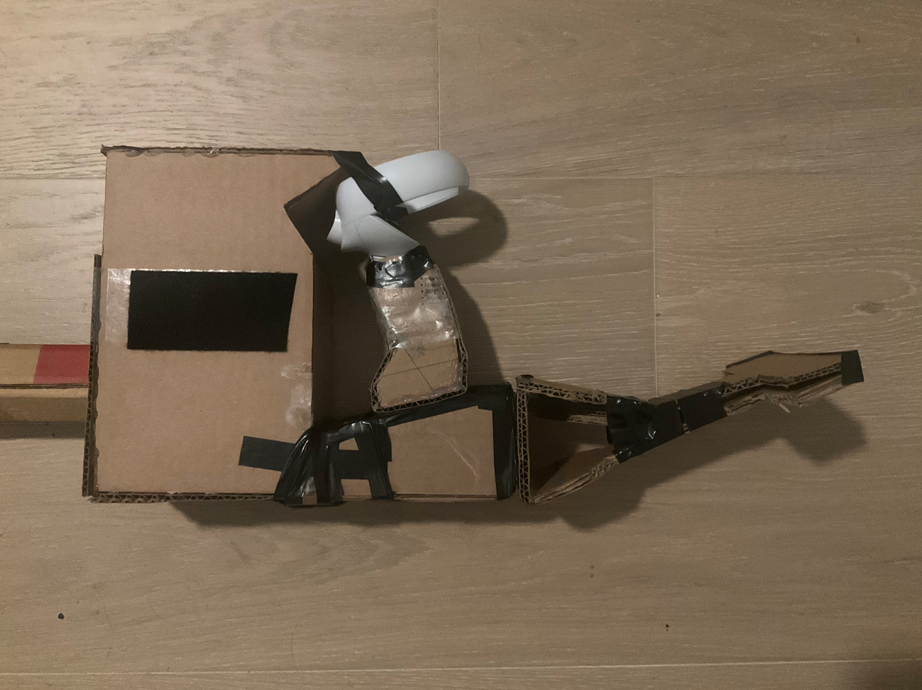
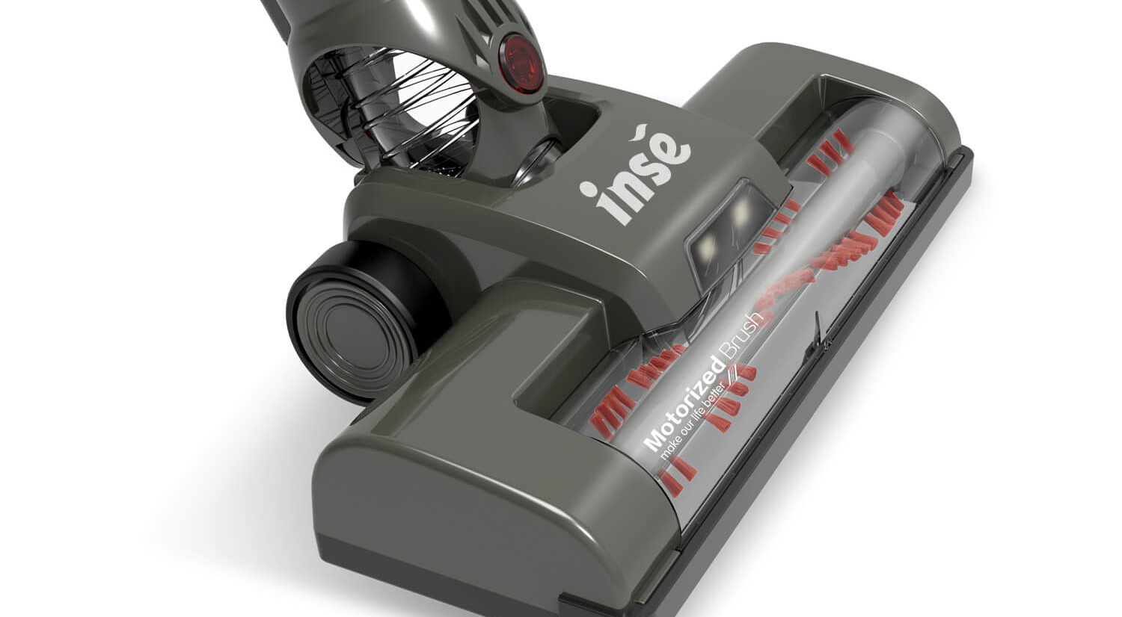
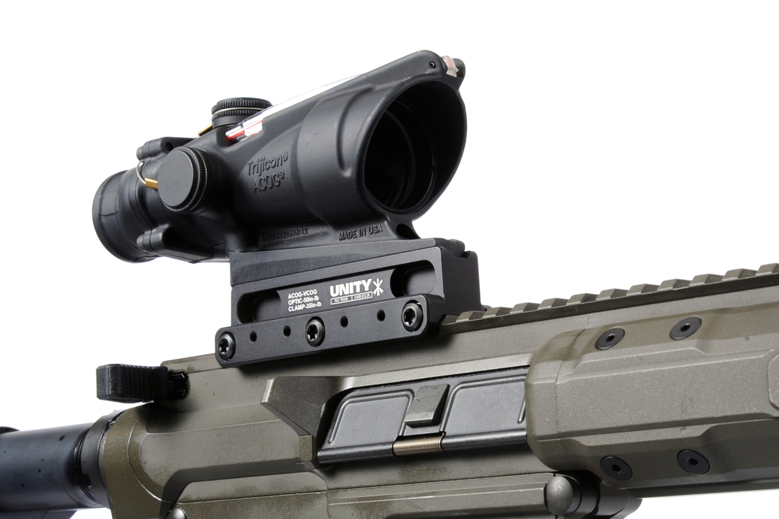
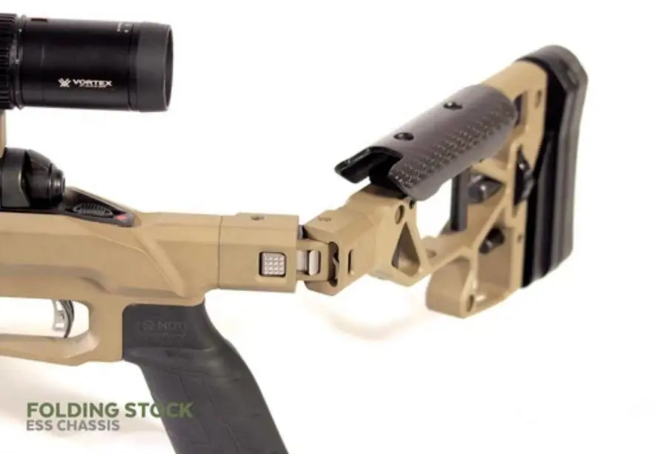
HARDWARE
+3D Printing +Multiple RFID Readers +More Attachments
Notes:
More Heads
Same heads on different socket can be used in different way.
Vacuum head – front = vacuum / Top = scope sight / end = stock

Slide 6
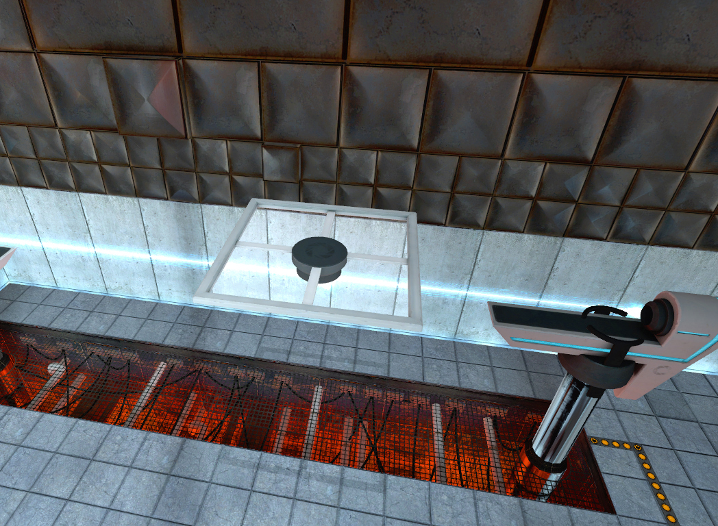
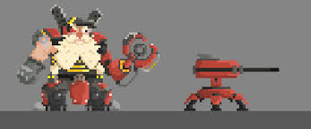
Migrate to Oculus Quest 2 Android Platform
Use “Look through” hand tracking feature
Engineering
Notes:
Moving platform and survival game in a Sci-Fi factory.
Defend the core of the platform with the multifunctional vacuum gun.
Collect scraps falling on the ground and use them as resource.
You can also build or repair turrets with the screwdriver head.

Slide 7
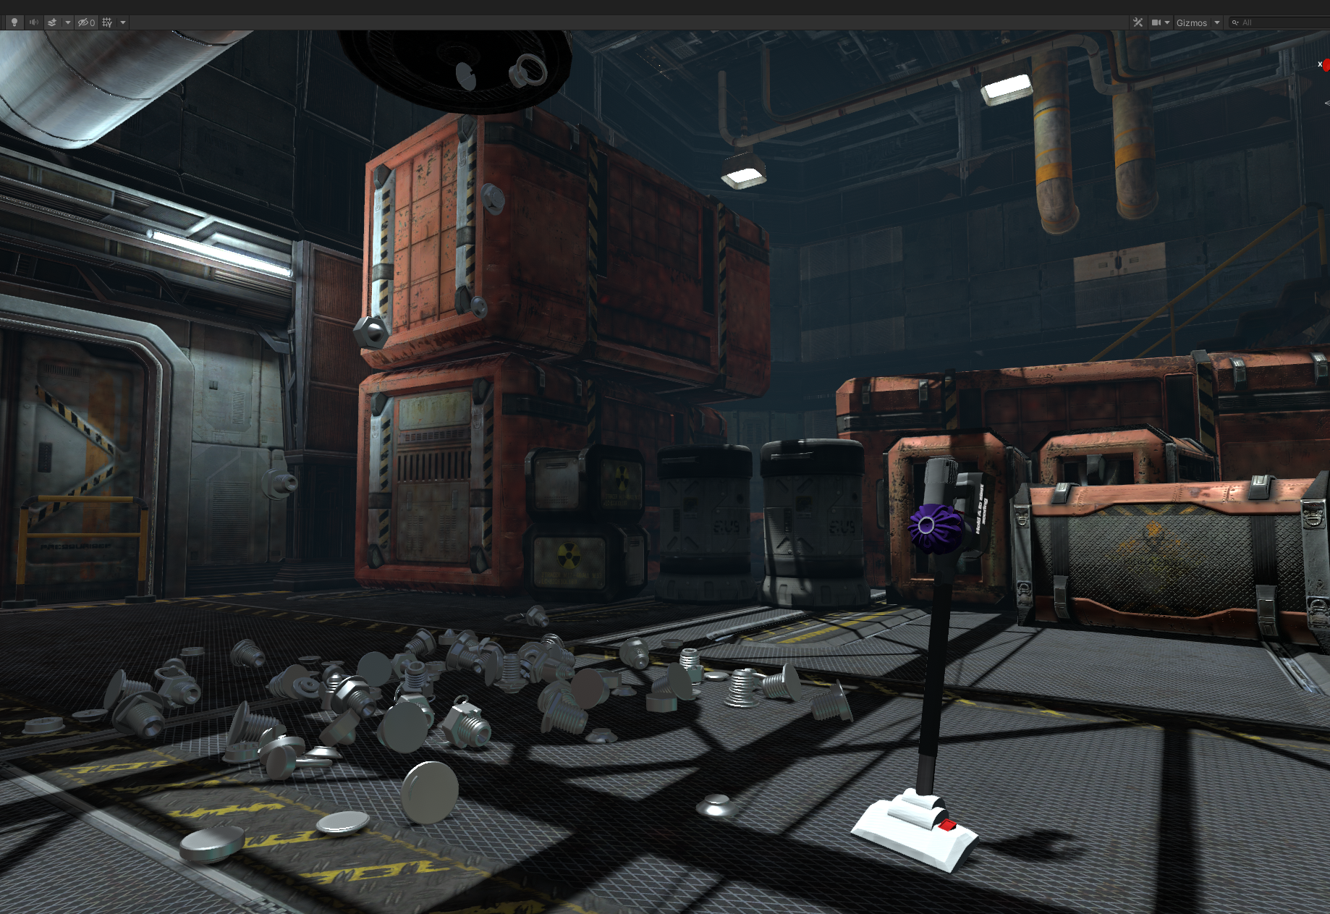
Art
Maintain Current Style: Sci-fi Industrial
Add Enemy Characters (i.e. Drones)
Use Amiibo-like Attachments

Slide 8


BUSINESS PLAN 1. VR Arcade game 2. Standalone toy/controller 3. Adaptation for regular VR controller and release a regular VR game version (SteamVR/Oculus)
Notes:
Open to more ideas

Slide 9
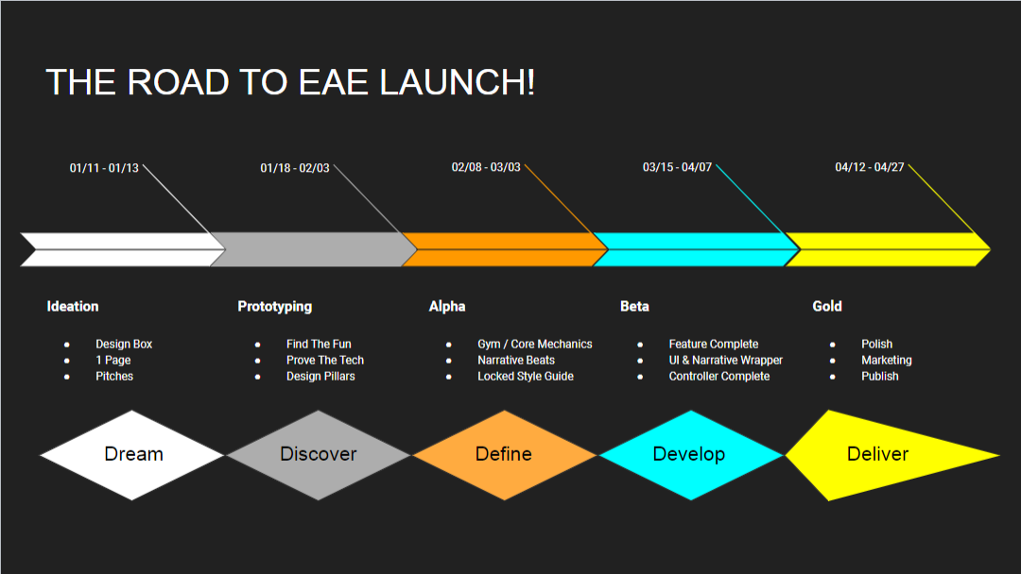

Slide 10
We need you!
Need to loan development equipment from EAE or GApp Lab:
i. Oculus Quest 2 x4~x12: Necessary for VR development
ii. Gaming Laptops with GPU better than RTX3070 x4~x12: Need laptops to develop/debug on-site. Need powerful GPU for VR development.
3D printing costs
Team Size 12 *But this is a student project so we don't get salary sadly : (

